Slide 1
ADHESIVES
Okatmos® star 100
Fast setting one side adhesive

Slide 2
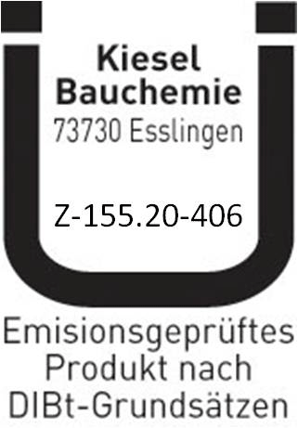
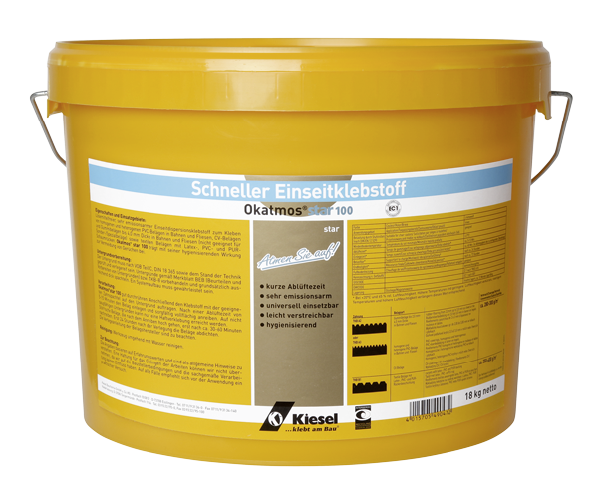
Fast setting one side adhesive
Okatmos® star 100
short ventilation time
very low emission
universally applicable
easy to spread
sanitising action

Slide 3
Which floor coverings
can be glued?
Homogeneous und heterogeneous
PVC floor coverings in sheets and tiles
Cushion-Vinyl (CV floorings)
LVT in tiles and planks
Rubber floor coverings of 2-4 mm
in sheets and tiles
Textile floor coverings
with latex-, PVC- and PUR backing

Slide 4
What is to be consedered
for the bonding?
The installations instructions from flooring manufacturers must always be considered.
When bonding rubber and LVT coverings the substrates must be adequately prepared through leveling or patching compounds.
absorbent surfaces et least 2 mm.
non absorbent Surfaces at least 3 mm.
The ventilation time / open time are varied depending on the type of flooring.
The trowel size as well as the consumption should also be selected depending on the type of flooring.

Slide 5
Okatmos® star 100
Specifications
Color | cream white
Application | interior
Suitable for chair castors | suitable (according to DIN EN 12529)
Minimum floor temperature | +17 °C / 63 °F
Ventilation time * | approx. 5 – 15 minutes
Open time * | approx. 40 minutes (covering dependable)
Ready for installation * | after approx. 24 hours
Final strength * | after approx 72 hours
Floor heating system | suitable
GISCODE | D 1 according to TRGS 610
EMICODE | EC 1 according to GEV
Storage | store in frost protected areas for up to 12 months
* At 68 °F (+20 °C) and 65 relative humidity

Slide 6
TOOLS and CONSUMPTION
Type of coverings | Trowel size | Consumption
Rubber floor coverings of 2-4 mm in sheets and tiles homogeneous and heterogeneous LVT coverings in sheets and tiles CV floor coverings | TKB A2 TKB A3 | approx. 300 – 350 g/m²
Textile coverings with latex-, PVC- and PUR-backing | TKB A1 | approx. 450 – 500 g/m²
Packaging and palletizing | 33 x 15 kg plastic buckets

